Slide 1



New Media Interventions for Sexual Health
July 22nd, 2018
Patrick S. Sullivan, PhD
Rollins School of Public Health

Slide 2
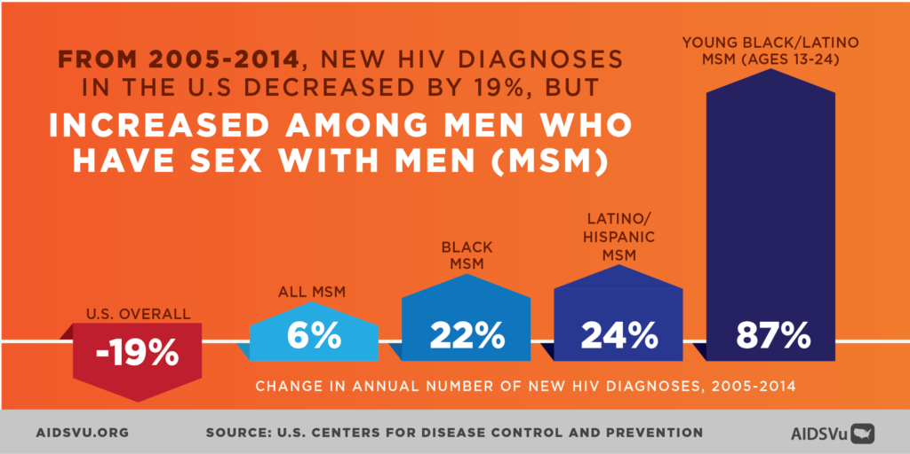
Notes:
Over 27.000 new MSM diagnoses in 2015

Slide 3
New Media
New media is:
Computers
Mobile phones
Website games
Social media
Internet
New media does:
Reach broad scale
Reach remote clients
Rich media
Tailoring
Reminders
Engagement

Slide 4
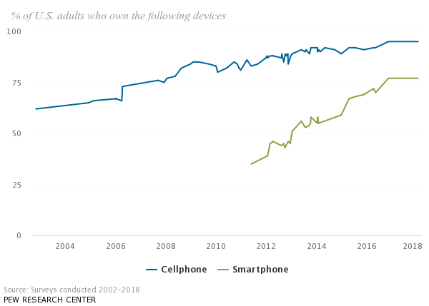
Pew Research Center, Mobile phone fact sheer, February 2018

Slide 5
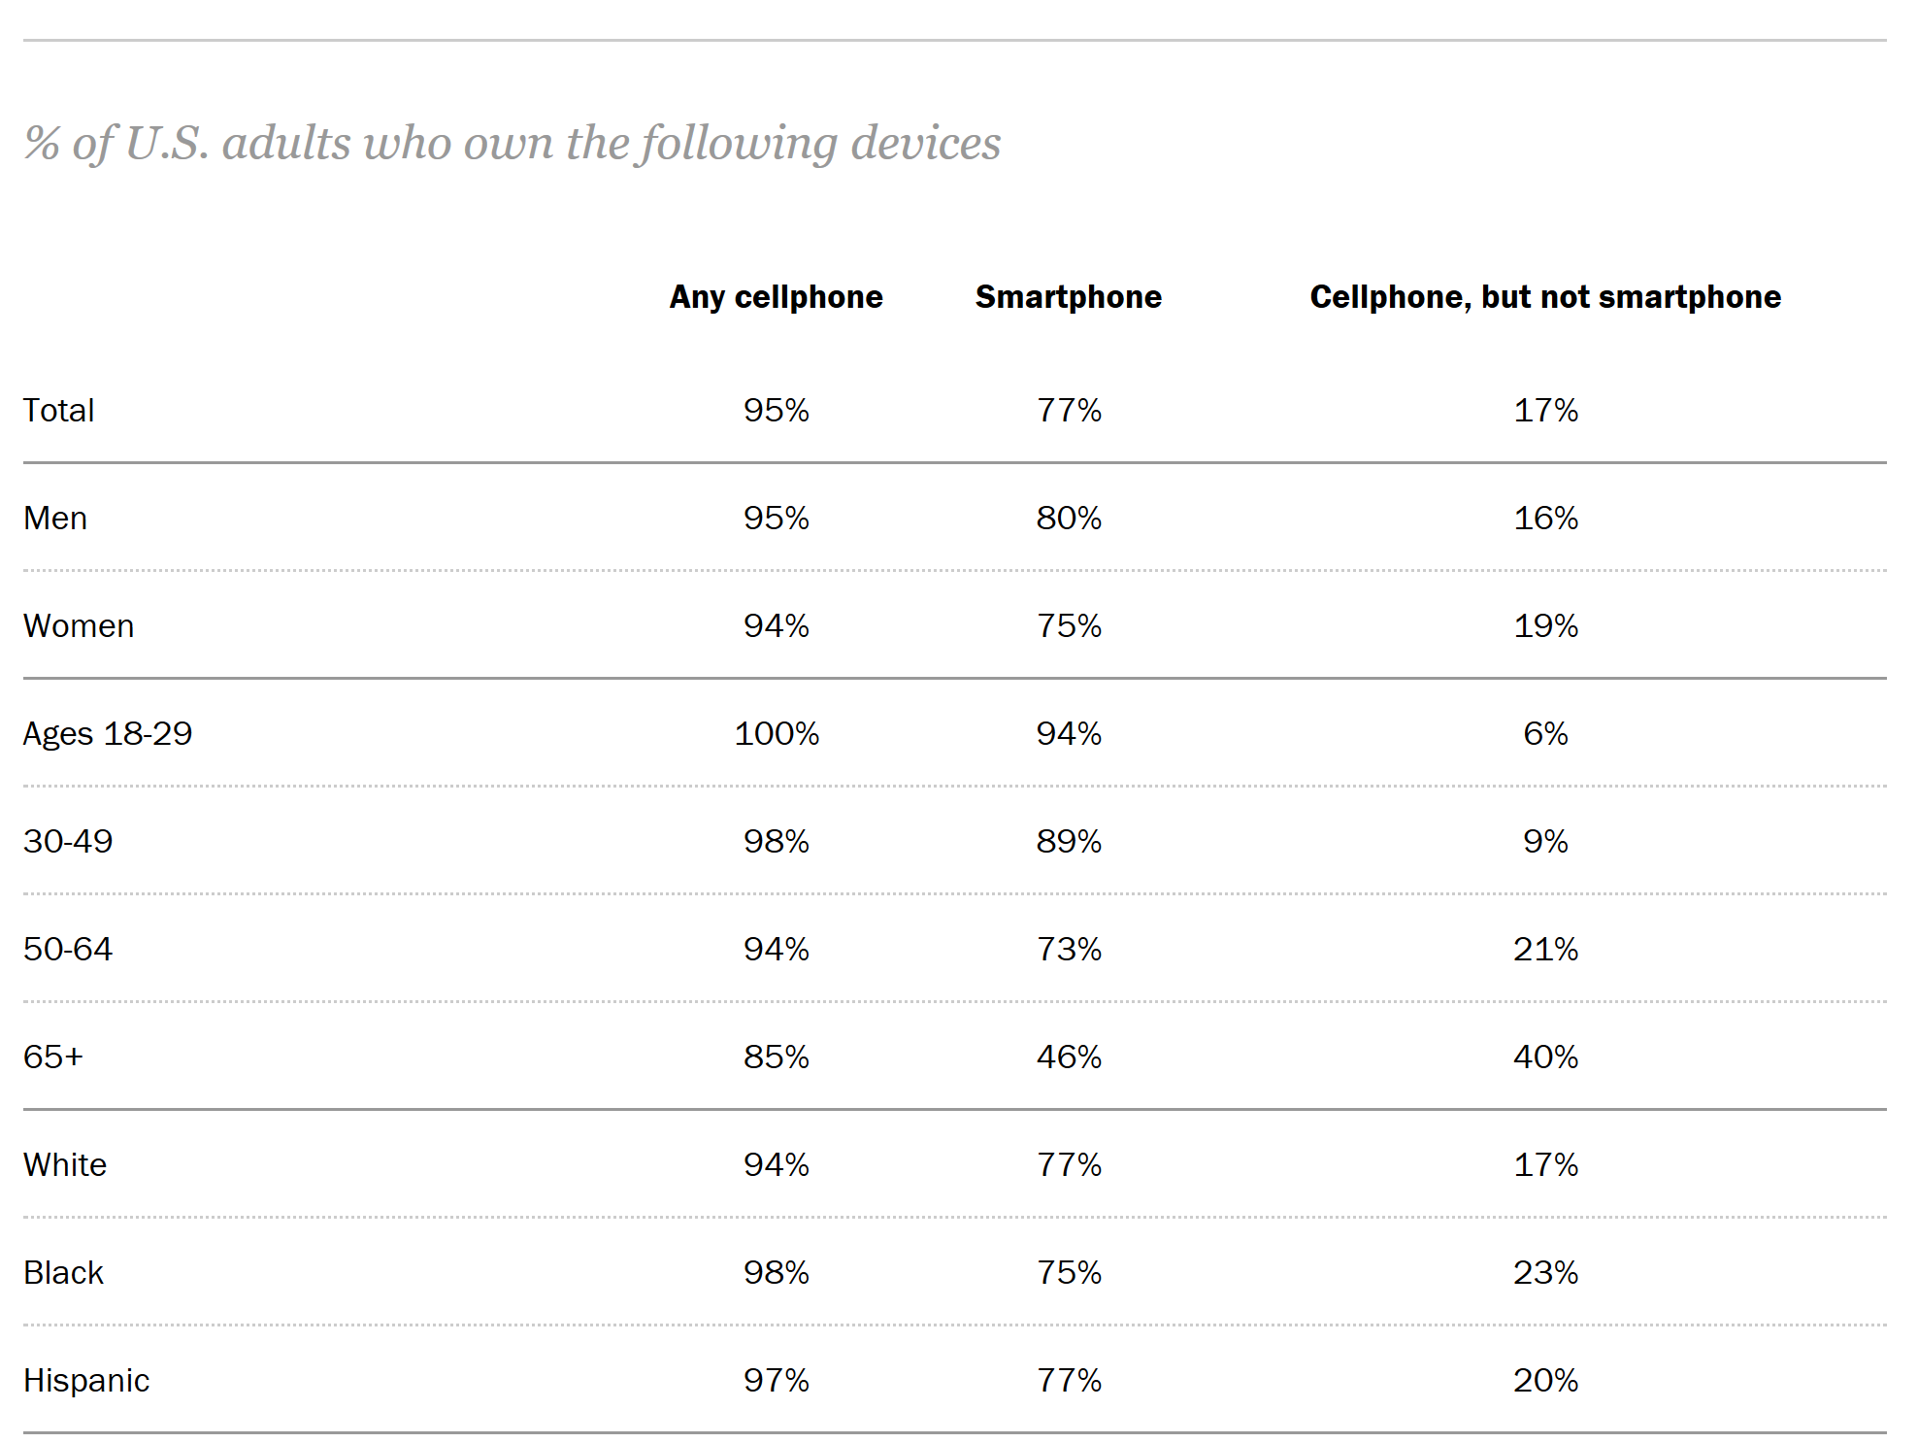
Pew Research Center, Mobile phone fact sheet, February 2018

Slide 6
Intervention: How much is enough?

Slide 7

Percent of HIV Infections Averted among MSM in South Africa, by Intervention Package
Source: Brookmeyer et al, PLoS ONE 2014

Slide 8
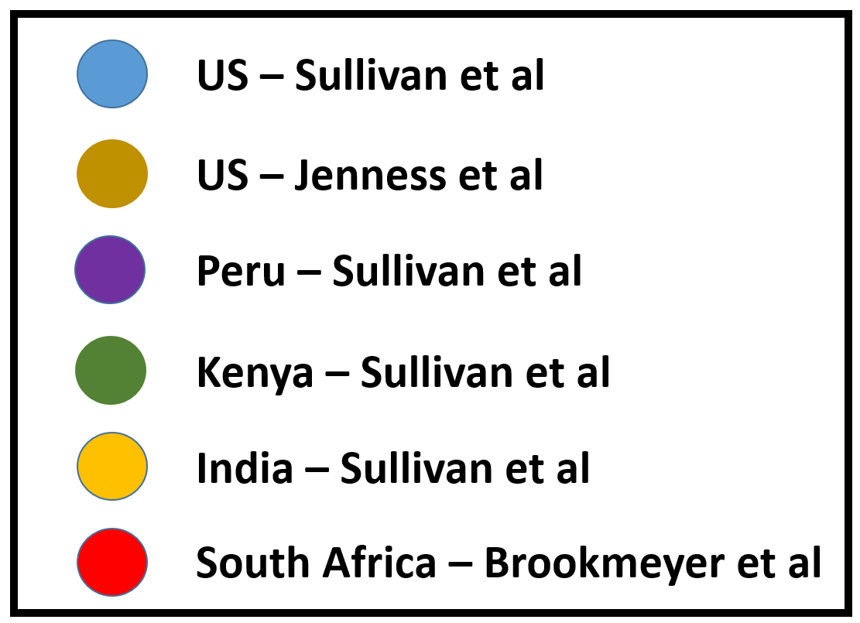
Proportion of HIV infections among MSM averted by PrEP, by level of coverage, US, Peru, Kenya, India, and South Africa
Sources: Sullivan et al., Lancet 2012; Brookmeyer et al PLoS ONE 2014; Jenness et al JID 2016

Slide 9
To make modest impacts on HIV transmissions among MSM, we will need to achieve 30-50% coverage of multiple interventions
So how are we doing?

Slide 10
Use of PrEP by year, US MSM, 2012-2016
Sources: Sanchez et al JMIR-Public Health 2015; 1(1): e1.
Sanchez et al JMIR-Public Health 2016; 2(1): e23.
Personal communication, Travis Sanchez
Notes:
Add citation

Slide 11
Use of STI Testing by US MSM by HIV status and positivity, 2012-2016
American Men’s Internet Survey; PI: Sanchez.
JMIR Public Health Surveill 2017;3(1):e13, AIDS Behav 2018 22:2413–2425

Slide 12
Use of Prevention Services Among Rural vs Urban MSM, 2012
1.00
0.83*
0.83*
0.86*
0.72*
0.70*
McKenney et al, in submission, 2017

Slide 13
How can new media help to increase the scale of sexual health interventions?
Increasing understanding of recommended services
Increasing motivation to use services
Navigating user to service locations
Reminding men to utilize services they have planned
Tailoring services to increase their relevance
Providing opportunities for mailout home-based sampling kits
Notes:
HealthMindr
Keep It Up
Get Connectect
iTech

Slide 14

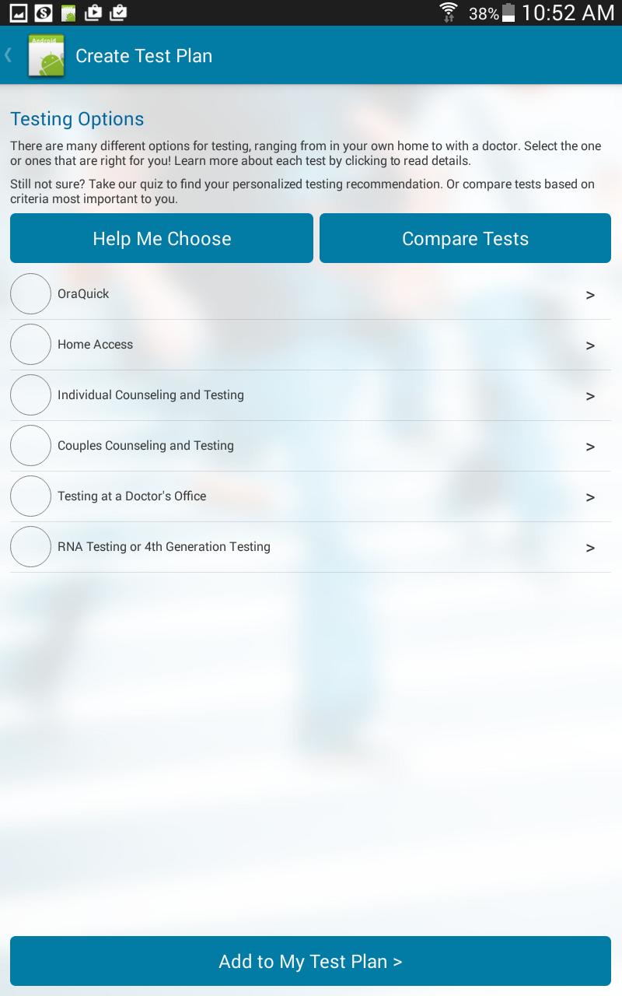
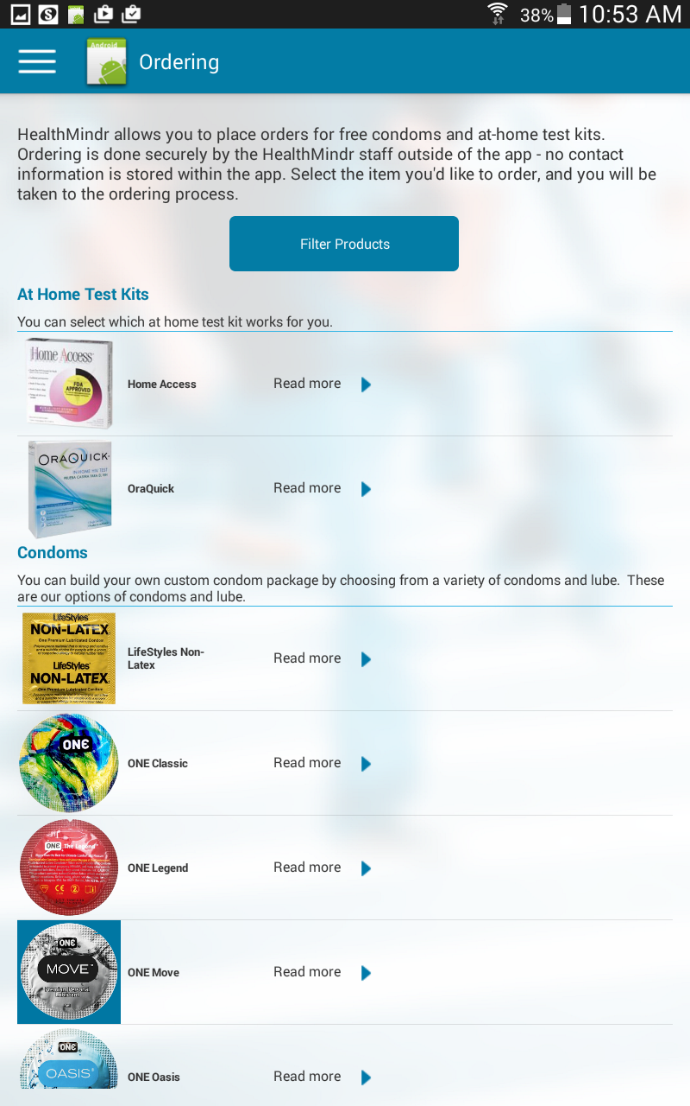

Slide 15
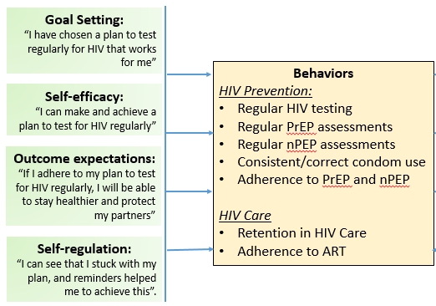

Theoretical basis for HealthMindr: Social Cognitive Theory

Slide 16
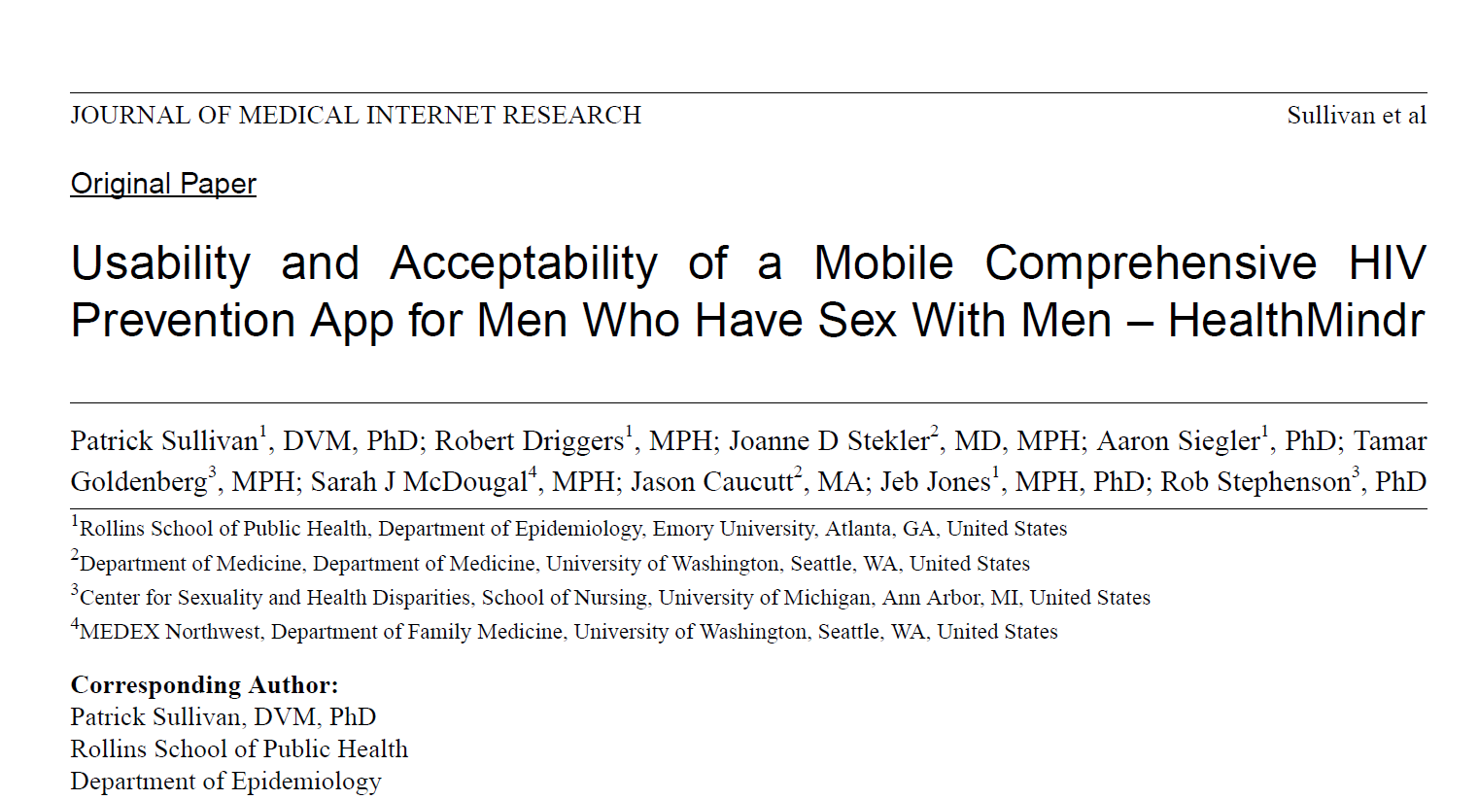
Source: Sullivan et al, JMIR 2017 (in press)

Slide 17
HealthMindr Pilot Study
Participants
121 MSM enrolled
  72 in Atlanta, GA
  49 in Seattle, WA
18+ years
Never tested HIV positive
Only available to Android users
4 month study
  Recruited from May-Aug
  Finish in December
99 have completed Final Evaluation
Notes:
Monthly assessments

Slide 18
Resources utilized, by category, among by 121 MSM participants during 4-month pilot study of a mobile prevention app, United States, 2015

Slide 19
Preliminary Evaluation Results (n=99)
78% of those reported dissatisfied with current condoms ordered new condoms
87% report using the ordered condoms
2/3 of HIV test kit orderers were not planning on being tested soon
67% of users who did not have a testing schedule now do
At study end, 83% of all MSM had a plan for regular testing
9% of PrEP-eligible men started PrEP

Slide 20




N=1200
+ messages
RCT
End: 10/2019
N=672
+ PrEP Content RCT
Ends: Fall 2020
N=3600
Comparative Effectiveness Study
N=115
Adolescents Pilot Study
+STI
+STI
+STI
+STI
M^3: PI: Sullivan, PO: Mansergh; HealthMindr: PI Sullivan, PD J. Jones; MyChoices PIs Biello/Mayer; iSTAMP PIs: Sullivan, Hightow-Weidman, Stephenson, PO: Macgowan

Slide 21
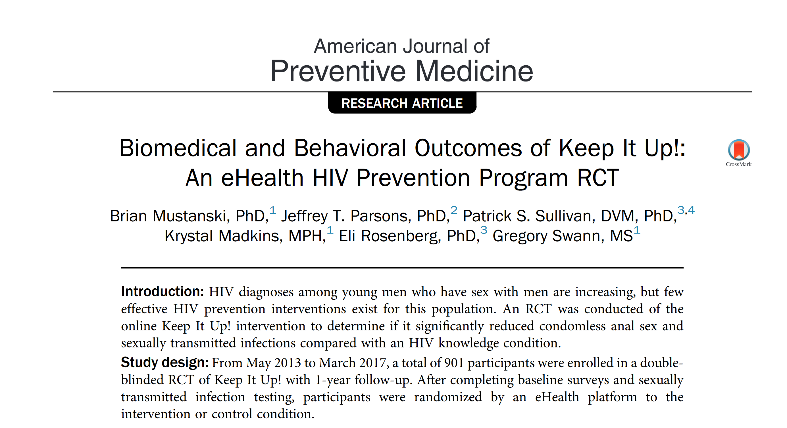
Mustanski et al, AJPM 2018

Slide 22
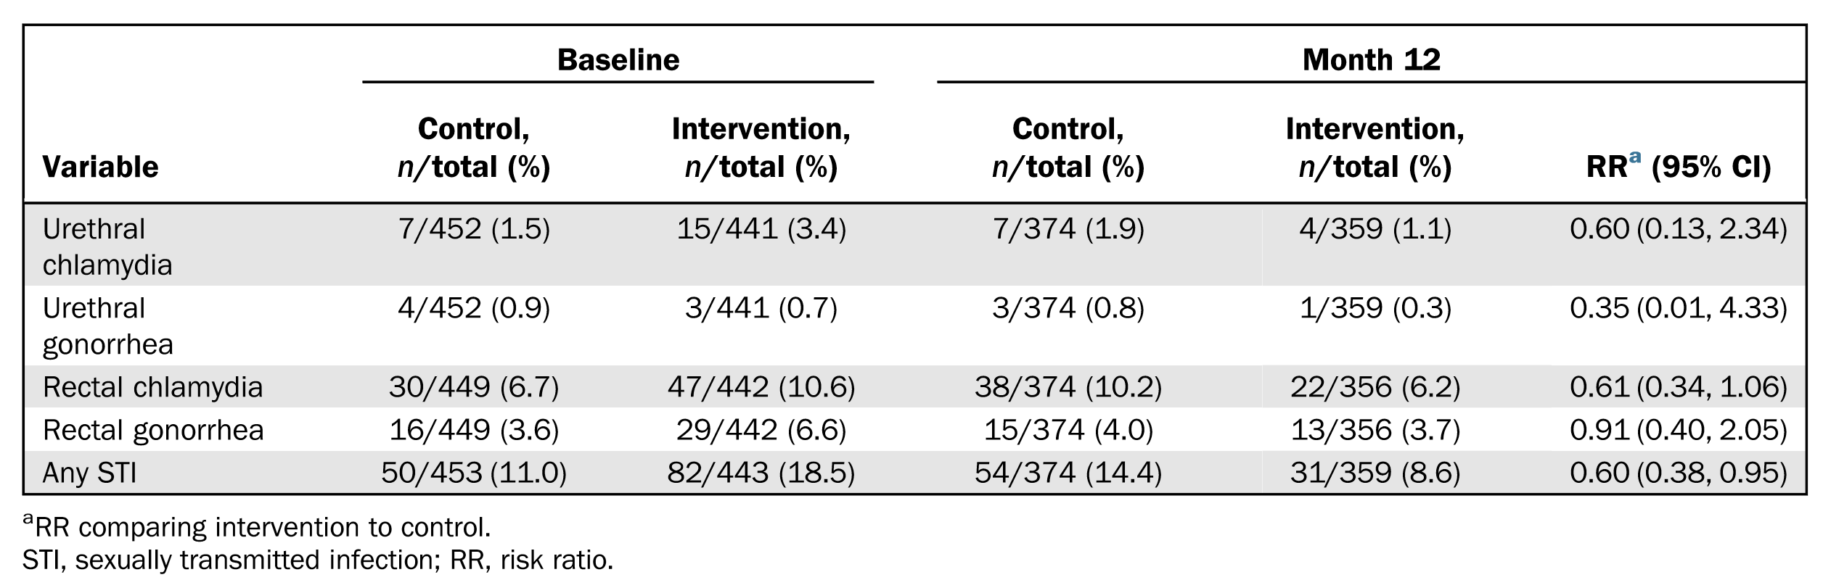
KIU: STI Outcomes
Intervention for young MSM who just tested HIV-negative
6 sessions plus boosters delivered by web app
Outcome: STI prevalence at 6 months
Mustanski et al, AJPM 2018

Slide 23
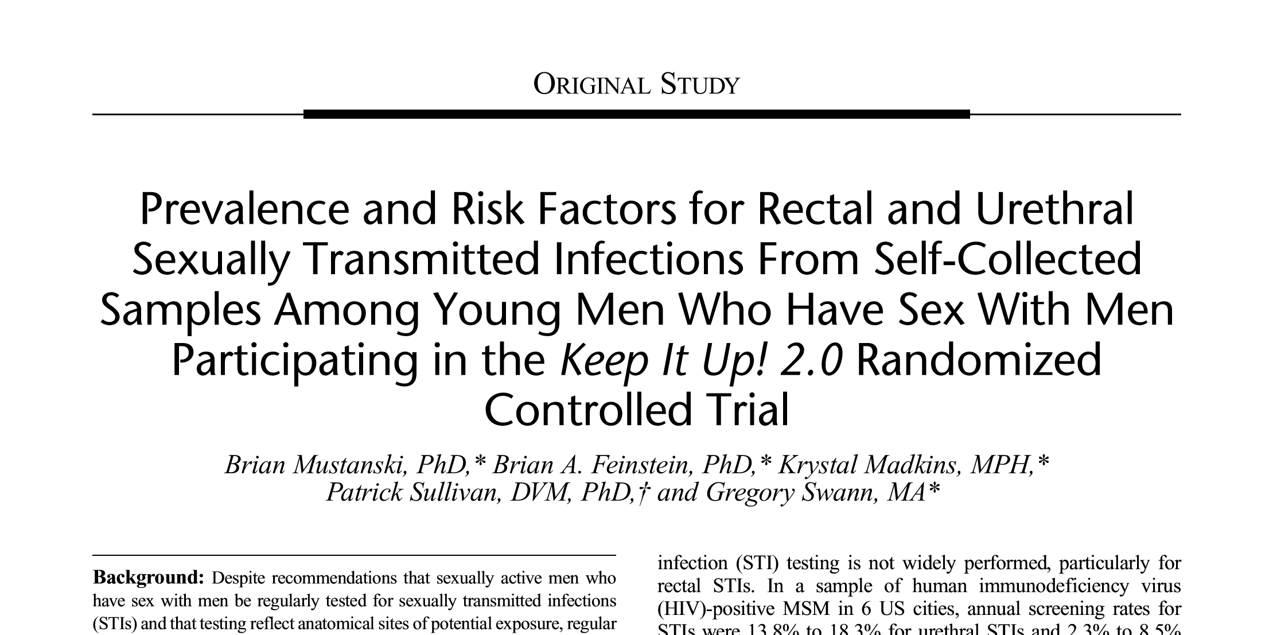
1113 at-home specimen collection kits distributed
1001 (89%) returned specimens
Rectal STI prevalence 12.9%
  Black: 14.5%
  White: 9.7%

Slide 24
Implementing technology-based interventions for youth: iTech and the ATN
UNC/Emory Center for Innovative Technology (iTech) across the Prevention and Care Continuum

Slide 25
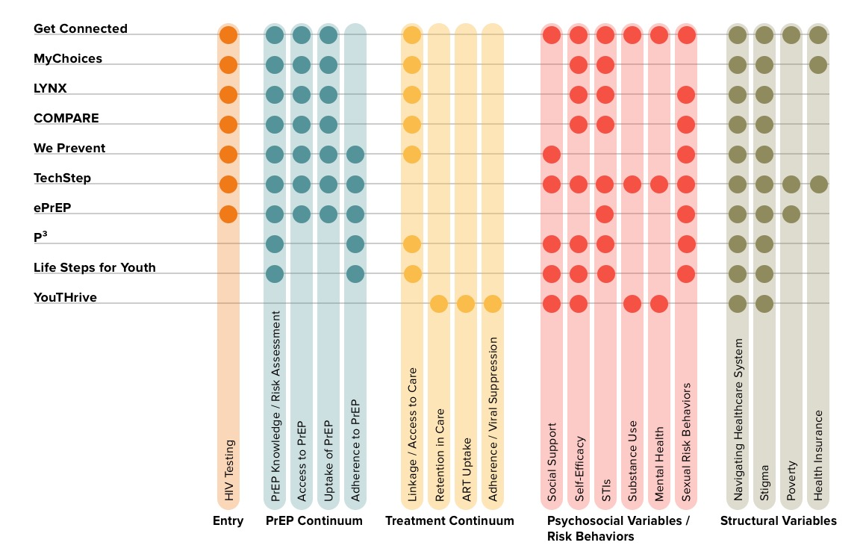
iTech Continuum of Care
Studies address the breadth of the prevention continuum, including structural and psychosocial variables

Slide 26








Highlights & Timelines
COMPARE
Highlights:
5 Aims completed (stars)
7 studies in the field
142 participants enrolled
Oct 2016
Oct 2017
Oct 2018
Oct 2019
Oct 2020
June 2021

Slide 27
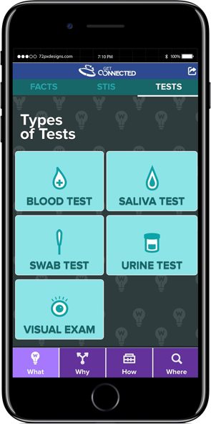
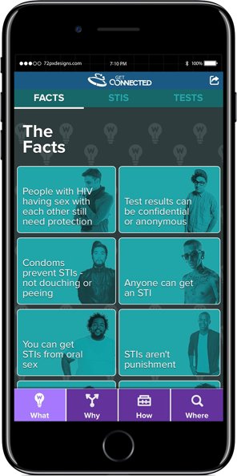
HIV Testing and PrEP Awareness
Mystery Shopping to inform app completed in Philadelphia and launching in Atlanta;
RCT just started in Philadelphia
A motivationally-based, brief online intervention that employs individual and systems-level tailoring technology to reduce barriers to linkage into competent HIV/STI prevention for YMSM.
Site Tailored On:
Age
Race/Ethnicity
Sexual Identity
HIV Testing
STI Testing
Structural Struggles
Sources of Support
Values
PIs: Bauermeister and Stephenson

Slide 28
Conclusions
In many countries, young MSM are especially heavily impacted by HIV and STIs
New media interventions have a unique opportunity to reach young MSM to promote use of basic prevention services, including STI testing
Mailout STI testing is highly acceptable to MSM. This is allowing more integration of STI testing into new media interventions.
STI outcomes are excellent outcomes for sexual health interventions
Tailoring might help make interventions more personalized and impactful
There is a large pipeline of eHealth interventions being developed and evaluated

Slide 29
Thanks:
  Aaron Siegler
  Travis Sanchez
  Rob Stephenson
  Joanne Stekler
  Jeb Jones
  Rob Driggers
  Brian Mustanski
  Jeff Parsons
  Lisa Hightow-Weidman
  Jose Bauermeister
Acknowledgements
  Emory CFAR: P30AI050409
  Centers for Disease Control and Prevention
  National Institutes of Health
  PRISM Health Research Group
  AIDSVu.org
Contact information:
Patrick Sullivan
pssulli@emory.edu

